Slide 1
Lecture 3
Structured programming & SDLC – Music Player

Slide 2
Structured programming
This simply means writing code in such a way its readable, interpretable, easy to debug and organized into functions, modules and packages

Slide 3
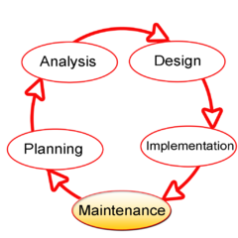
Software development life cycle
This is the whole process a software undergoes before its deployed
Preliminary Investigation
System analysis
System design
System implementation
Testing and integration
System maintenance and evaluation

